Slide 1
TOGAF 9.1
By: Samuel Mandebvu

Slide 2
Welcome!
This presentation is for you if:
Want to know what TOGAF is and what its all about.
Have gone through the training and are now studying to write the exams.
Lets get started:
Start
Start

Slide 3
TOGAF 9.1 Parts
Part I – Introduction
Part II – The ADM
Part III - ADM Guidelines and Techniques
Part IV - Architecture Content Framework
Part V - Enterprise Continuum and Tools
Part VI - Reference Models
Part VII - Architecture Capability Framework

Slide 4
What is TOGAF?
TOGAF is an architecture framework – The Open Group Architecture Framework.
TOGAF is a tool for assisting in the acceptance, production, use, and maintenance of enterprise architectures.
The first version of TOGAF, developed in 1995, was based on the US Department of Defense Technical Architecture Framework for Information Management (TAFIM).
The key to TOGAF is the method – the TOGAF Architecture Development Method (ADM) – for developing an enterprise architecture that addresses business needs.

Slide 5
What is Architecture in the Context of TOGAF?
In TOGAF, “architecture” has two meanings depending upon the context:
1. A formal description of a system, or a detailed plan of the system at a component level to guide its implementation.
2. The structure of components, their inter-relationships, and the principles and guidelines governing their design and evolution over time.

Slide 6
Key Terms
Activity: A task or collection of tasks that support the functions of an organization; for example, a user entering data into an IT system or traveling to visit customers.
Application :A deployed and operational IT system that supports business functions and services; for example, a payroll. Applications use data and are supported by multiple technology components but are distinct from the technology components that support the application.
Application Architecture : A description of the major logical grouping of capabilities that manage the data objects necessary to process the data and support the business.
Building Block :Represents a (potentially re-usable) component of business, IT, or architectural capability that can be combined with other building blocks to deliver architectures and solutions.
Architecture Building Block (ABB) :A constituent of the architecture model that describes a single aspect of the overall model.
Business Architecture :The business strategy, governance, organization, and key business processes information, as well as the interaction between these concepts.
Architecture Principles :A qualitative statement of intent that should be met by the architecture. Has at least a supporting rationale and a measure of importance.

Slide 7
Key Terms
Architecture Continuum :A part of the Enterprise Continuum. A repository of architectural elements with increasing detail and specialization. This Continuum begins with foundational definitions such as reference models, core strategies, and basic building blocks. From there it spans to Industry Architectures and all the way to an organization’s specific architecture.
Architecture Development Method (ADM) :The core of TOGAF. A step-by-step approach to develop and use an enterprise architecture.
Architecture Domain :The architectural area being considered. There are four architecture domains within TOGAF: Business, Data, Application, and Technology.
Architecture Framework :A foundational structure, or set of structures, which can be used for developing a broad range of different architectures. It should contain a method for designing an information system in terms of a set of building blocks, and for showing how the building blocks fit together. It should contain a set of tools and provide a common vocabulary. It should also include a list of recommended standards and compliant products that can be used to implement the building blocks.

Slide 8
Key Terms
Architecture View : A view is a representation of a system from the perspective of a related set of concerns. A view is what you see (or what a stakeholder sees). Views are specific.
Architecture Viewpoint: where you are looking from; the vantage point or perspective. Viewpoints are generic. A model (or description) of the information contained in a view.
Architecture Vision : A high-level, aspirational view of the Target Architecture. / A phase in the ADM which delivers understanding and definition of the Architecture Vision /Level of granularity of work to be done.
Baseline :A specification that has been formally reviewed and agreed upon, that thereafter serves as the basis for further development or change and that can be changed only through formal change control procedures or a type of procedure such as configuration management.
Baseline Architecture :The existing defined system architecture before entering a cycle of architecture review and redesign.

Slide 9
Key Terms
Business Governance :Concerned with ensuring that the business processes and policies (and their operation) deliver the business outcomes and adhere to relevant business regulation.
Capability :An ability that an organization, person, or system possesses. Capabilities are typically expressed in general and high-level terms and typically require a combination of organization, people, processes, and technology to achieve; or example, marketing, customer contact, or outbound telemarketing.
Concerns :The key interests that are crucially important to the stakeholders in a system, and determine the acceptability of the system. Concerns may pertain to any aspect of the system’s functioning, development, or operation, including considerations such as performance, reliability, security, distribution, and evolvability. Longer lasting than problem (eg. state of the economy), not a requirement, which is short term.
Enterprise : The highest level (typically) of description of an organization and typically covers all missions and functions. An enterprise will often span multiple organizations.
A "pattern" has been defined as: "an idea that has been useful in one practical context and will probably be useful in others" [Analysis Patterns - Re-usable Object Models].

Slide 10
The ADM
The ADM supports the concept of iteration at three levels:
Cycling around the ADM: The ADM is presented in a circular manner indicating that the completion of one phase of architecture work directly feeds into subsequent phases of architecture work.
Iterating between phases: TOGAF describes the concept of iterating across phases (e.g., returning to Business Architecture on completion of Technology Architecture).
Cycling around a single phase: TOGAF supports repeated execution of the activities within a single ADM phase as a technique for elaborating architectural content.

Slide 11
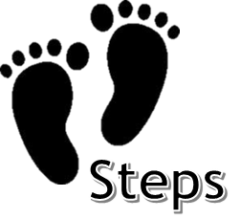
ADM
Preliminary
9 Phases
The TOGAF ADM is framework-agnostic, and helps IT architects fill in the
framework they might already have in use.
4 Domains (B.D.A.T)
A.
Architecture
Vision
H.
B.
1.Business
Architecture
Change
Management
Business
Architecture
G.
C.
2.Data
Implementation
Governance
Requirements
Management
I.S
Architectures
3.Application
F.
D.
Migration
Planning
Technology
Architecture
4.Technology
E.
Opportunities
&
Solutions

Slide 12
Preliminary
O
The Preliminary Phase describes the preparation and initiation activities required to prepare to meet the business directive for a new enterprise architecture, including the definition of an Organization-Specific Architecture framework and the definition of principles.

Slide 13
Objective
Prepare the organization for successful TOGAF architecture projects.
Undertake the preparation and initiation activities required to meet the business directive for a new enterprise architecture, including the definition of an Organization-Specific Architecture framework and tools, and the definition of principles.
The Preliminary Phase is about defining “where, what, why, who, and how we do architecture” in the enterprise concerned.

Slide 14
Approach
The main aspects are as follows:
Defining the enterprise.
Identifying key drivers and elements in the organizational context.
Defining the requirements for architecture work.
Defining the architecture principles that will inform any architecture work.
Defining the framework to be used
Defining the relationships between management frameworks
Evaluating the enterprise architecture’s maturity

Slide 15
Defining the Enterprise
“How big is this animal?”
The enterprise scope will determine those stakeholders who will derive most benefit from the new or enhanced enterprise architecture.
It is important to appoint a sponsor at this stage.
The enterprise may include many organizations and the duty of the sponsor is to ensure that all stakeholders are included in some part of the architecture work.

Slide 16
Identifying key drivers and elements in the organizational context
It is necessary to understand the context surrounding the architecture. For example, considerations include:
The commercial models and budget for the enterprise architecture.
The stakeholders.
The intentions and culture of the organization.
Current processes that support execution of change and operation of IT.
The Baseline Architecture landscape.
The skills and capabilities of the enterprise.

Slide 17
Defining The Requirements For Architecture Work
Business imperatives drive the requirements and performance metrics. One or more of the following requirements need to be articulated so that the sponsor can identify the key decision-makers and stakeholders and generate a Request for Architecture Work:
Business requirements
Cultural aspirations
Organization intents
Strategic intent
Forecast financial requirements

Slide 18
Defining The Architecture Principles
Architecture work is informed by business principles as well as architecture principles.
The architecture principles themselves are also normally based in part on business principles.
Principles are general rules and guidelines, intended to be enduring and seldom amended, that inform and support the way in which an organization sets about fulfilling its mission.
Depending on the organization, principles may be established within different domains and at different levels. Two key domains inform the development and utilization of architecture:
Enterprise principles provide a basis for decision-making throughout an enterprise, and inform how the organization sets about fulfilling its mission.
Architecture principles are a set of principles that relate to architecture work. They reflect a level of consensus across the enterprise, and embody the spirit and thinking of existing enterprise principles.

Slide 19
Example Principle
Statement:
Enterprise operations are maintained in spite of system interruptions.
Rationale:
As system operations become more pervasive, we become more dependent on them; therefore, we must consider the reliability of such systems throughout their design and use. Business premises throughout the enterprise must be provided with the capability to continue their business functions regardless of external events. Hardware failure, natural disasters, and data corruption should not be allowed to disrupt or stop enterprise activities. The enterprise business functions must be capable of operating on alternative information delivery mechanisms.
Implications:
Dependency on shared system applications mandates that the risks of business interruption must be established in advance and managed.
Management includes but is not limited to periodic reviews, testing for vulnerability and exposure, or designing mission-critical services to ensure business function continuity through redundant or alternative capabilities.
Recoverability, redundancy, and maintainability should be addressed at the time of design.
Applications must be assessed for criticality and impact on the enterprise mission, in order to determine what level of continuity is required and what corresponding recovery plan is necessary.

Slide 20
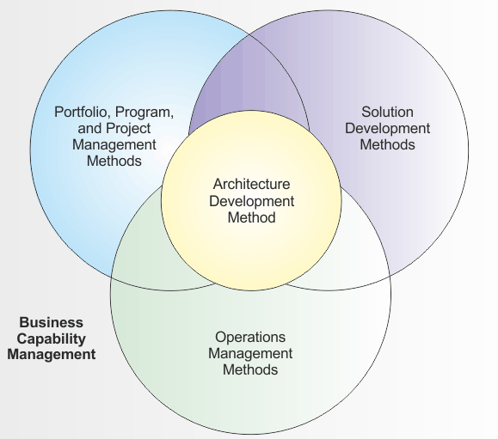
Management Frameworks
TOGAF has to co-exist with and enhance the operational capabilities of other management frameworks that are present within any organization either formally or informally.
The main frameworks suggested to be co-ordinated with TOGAF are:
Business Capability Management (Business Direction and Planning) that determines what business capabilities are required to deliver business value including the definition of return on investment and the requisite control/performance measures.
Portfolio/Project Management Methods that determine how a company manages its change initiatives.
Operations Management Methods that describe how a company runs its day-to-day operations, including IT.
Solution Development Methods that formalize the way that business systems are delivered in accordance with the structures developed in the IT architecture.

Slide 21
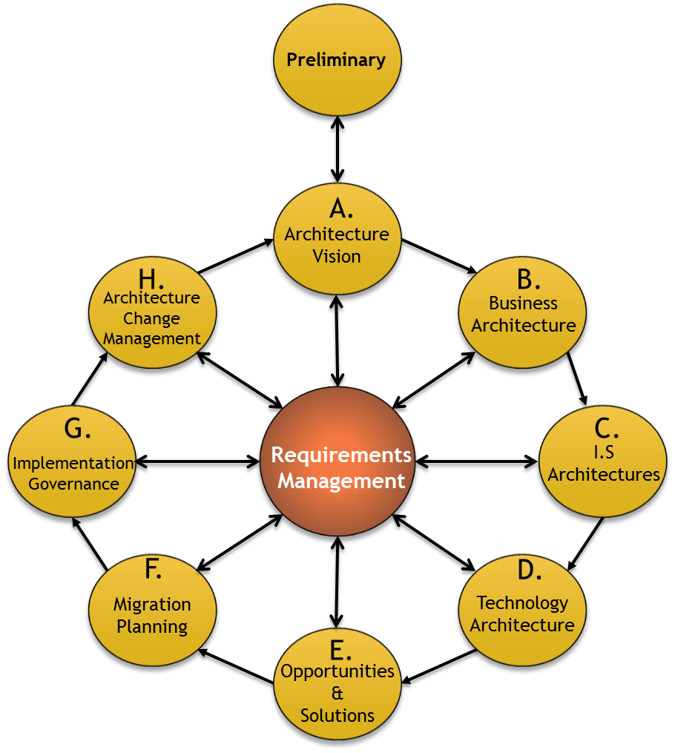
Preliminary Phase Steps
The order of the steps should be adapted to the situation. In particular you should determine whether it is appropriate to do the Baseline Business Architecture or Target Business Architecture development first
1. Scope the Enterprise Organizations Impacted
2. Confirm Governance and Support Frameworks
3. Define and Establish Enterprise Architecture Team and Organization
4. Identify and Establish Architecture Principles
5. Tailor TOGAF and, if any, Other Selected Architecture Framework(s)
6. Implement Architecture Tools

Slide 22
Architecture Vision
A
Describes the initial phase of an Architecture Development Cycle. It includes information about defining the scope, identifying the stakeholders, creating the Architecture Vision, and obtaining approvals.

Slide 23
Objective
Develop a high-level aspirational vision of the capabilities and business value to be delivered as a result of the proposed enterprise architecture.
Set the scope, constraints, and expectations for a TOGAF project.
Create the Architecture Vision.
Define stakeholders.
Validate the business context and create the Statement of Architecture Work.
Obtain approvals for Statement of Architecture Work.

Slide 24
Creating the Architecture Vision
The Architecture Vision provides the sponsor with a key tool to sell the benefits of the proposed capability to stakeholders and decision-makers within the enterprise.
Architecture Vision describes how the new capability will meet the business goals and strategic objectives and address the stakeholder concerns when implemented.
The Architecture Vision provides a first-cut, high-level description of the Baseline and Target Architectures, covering the business, data, application, and technology domains.
Business scenarios are an appropriate and useful technique to discover and document business requirements, and to articulate an Architecture Vision that responds to those requirements.

Slide 25
Business Scenarios
1. Problem
Identifying, documenting, and ranking the problem driving the scenario.
2. Environment
Identifying the business and technical environment of the scenario and documenting it in scenario models.
3. Objectives
Identifying and documenting desired objectives (the results of handling the problems successfully); get "SMART“.
Specific
Measureable
Actionable
Realistic
Time-bound
4. Human Actors
Identifying the human actors (participants) and their place in the business model
5. Computer Actors
Identifying computer actors (computing elements) and their place in the technology mode
6. Roles & Responsibilities
Identifying and documenting roles, responsibilities
7. Refine
Checking for "fitness-for-purpose" and refining only if necessary

Slide 26
Phase A Steps
1. Establish the Architecture Project
2. Identify Stakeholders, Concerns, and Business Requirements
The order of the steps should be adapted to the situation. In particular you should determine whether it is appropriate to do the Baseline Business Architecture or Target Business Architecture development first
3. Confirm and Elaborate Business Goals, Business Drivers, and Constraints
4. Evaluate Business Capabilities
5. Assess Readiness for Business Transformation
6. Define Scope
7. Confirm and Elaborate Architecture Principles, including Business Principles
8. Develop Architecture Vision
9. Define the Target Architecture Value Propositions and KPIs
10. Identify the Business Transformation Risks and Mitigation Activities
11. Develop Statement of Architecture Work; Secure Approval

Slide 27
Business Architecture
B
Describes the development of a Business Architecture to support an agreed Architecture Vision.

Slide 28
Objective
Develop the Target Business Architecture that describes how the enterprise needs to operate to achieve the business goals, and respond to the strategic drivers set out in the Architecture Vision, in a way that addresses the Request for Architecture Work and stakeholder concerns
Identify candidate Architecture Roadmap components based upon gaps between the Baseline and Target Business Architectures

Slide 29
Developing the Baseline Description
If an enterprise has existing architecture descriptions, they should be used as the basis for the Baseline Description.
The normal approach to Target Architecture development is top-down.
In the Baseline Description, however, the analysis of the current state often has to be done bottom-up, particularly where little or no architecture assets exist.
Whatever the approach, the goal should be to re-use existing material as much as possible, and to gather and analyze only that information that allows informed decisions to be made regarding the Target Business Architecture.
“It is important to build a complete picture without going into unnecessary detail.”

Slide 30
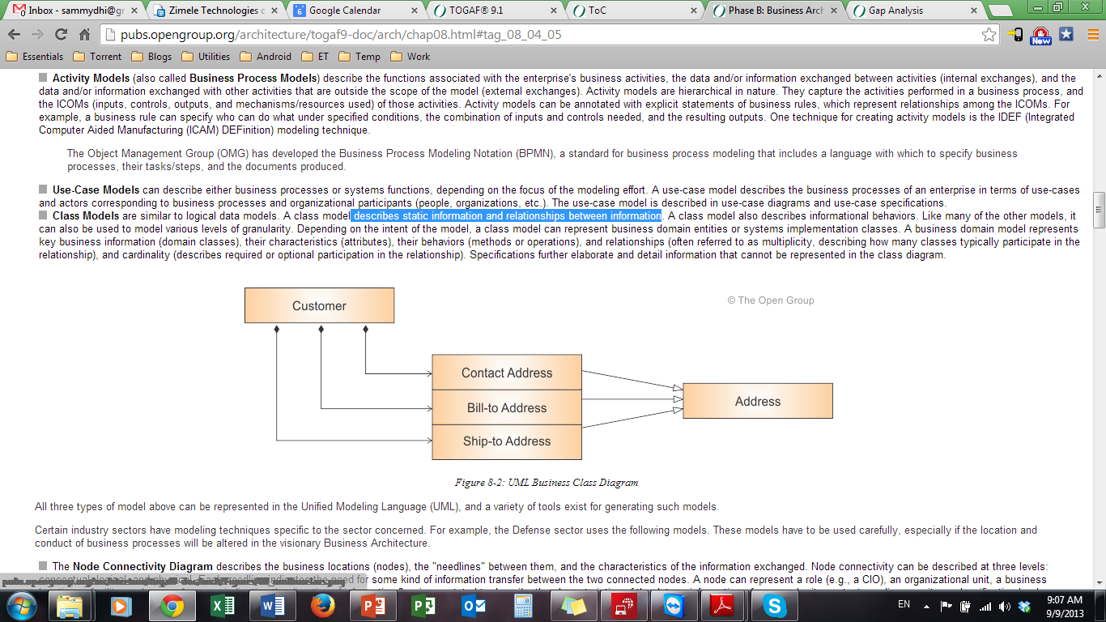
Business Modelling
Business models should be logical extensions of the business scenarios from the Architecture Vision, so that the architecture can be mapped from the high-level business requirements down to the more detailed ones.
A variety of modelling tools and techniques may be employed:
Activity Models (also called Business Process Models) : describe the functions associated with the enterprise's business activities, the data and/or information exchanged between activities.
Use-Case Models: can describe either business processes or systems functions, depending on the focus of the modelling effort.
Class Models : describes static information and relationships between information.

Slide 31
Architecture Repository
As part of Phase B, the architecture team will need to consider what relevant Business Architecture resources are available from the Architecture Repository. In Particular:
Generic business models relevant to the organization's industry sector. These are "Industry Architectures", in terms of the Enterprise Continuum.
Business models relevant to common high-level business domains.
Enterprise-specific building blocks (process components, business rules, job descriptions, etc.).

Slide 32
The Architecture Repository
Supporting the Enterprise Continuum is the concept of an Architecture Repository which can be used to store different classes of architectural output at different levels of abstraction, created by the ADM.
The major components within an Architecture Repository are as follows:
The Architecture Metamodel describes the organizationally tailored application of an architecture framework, including a metamodel for architecture content.
The Architecture Capability defines the parameters, structures, and processes that support governance of the Architecture Repository.
The Architecture Landscape shows an architectural view of the building blocks that are in use within the organization today (e.g., a list of the live applications). The landscape is likely to exist at multiple levels of abstraction to suit different architecture objectives.
The Standards Information Base (SIB) captures the standards with which new architectures must comply, which may include industry standards, selected products and services from suppliers, or shared services already deployed within the organization.
The Reference Library provides guidelines, templates, patterns, and other forms of reference material that can be leveraged in order to accelerate the creation of new architectures for the enterprise.
The Governance Log provides a record of governance activity across the enterprise.

Slide 33
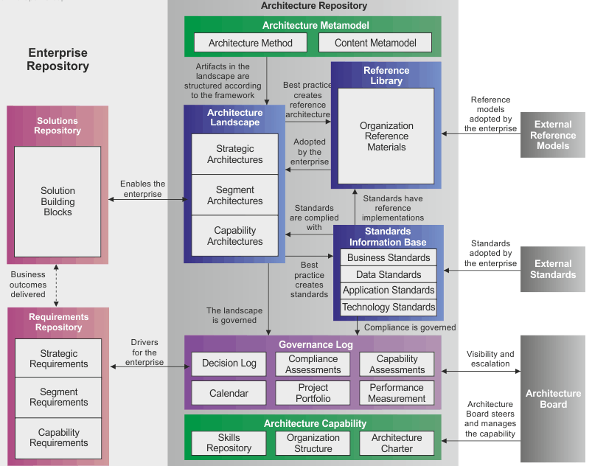
The Architecture Repository

Slide 34
Phase B Steps
1. Select reference models, viewpoints, and tools
The order of the steps should be adapted to the situation. In particular you should determine whether it is appropriate to do the Baseline Business Architecture or Target Business Architecture development first
2. Develop Baseline Business Architecture Description
3. Develop Target Business Architecture Description
4. Perform gap analysis
5. Define roadmap components
6. Resolve impacts across the Architecture Landscape
7. Conduct formal stakeholder review
8. Finalize the Business Architecture
9. Create Architecture Definition Document

Slide 35
Information Systems Architectures
C
Describes the development of Information Systems Architectures for an architecture project, including the development of Data and Application Architectures.

Slide 36
Objective
Develop the Target Information Systems (Data and Application) Architecture, describing how the enterprise's Information Systems Architecture will enable the Business Architecture and the Architecture Vision, in a way that addresses the Request for Architecture Work and stakeholder concerns.
Identify candidate Architecture Roadmap components based upon gaps between the Baseline and Target Information Systems (Data and Application) Architectures.

Slide 37
Data Architecture part of Phase C (Objectives)
Develop the Target Data Architecture that enables the Business Architecture and the Architecture Vision, while addressing the Request for Architecture Work and stakeholder concerns
Identify candidate Architecture Roadmap components based upon gaps between the Baseline and Target Data Architectures

Slide 38
Key Considerations for Data Architecture
Data Management
Considerations include:
A clear definition of which application components in the landscape will serve as the system of record or reference for enterprise master data.
Will there be an enterprise-wide standard that all application components, including software packages, need to adopt?
Clearly understand how data entities are utilized by business functions, processes, and services.
Clearly understand how and where enterprise data entities are created, stored, transported, and reported.
What is the level and complexity of data transformations required to support the information exchange needs between applications?
What will be the requirement for software in supporting data integration with the enterprise's customers and suppliers?

Slide 39
Key Considerations for Data Architecture
Data Migration
Considerations include:
When an existing application is replaced, there will be a critical need to migrate data (master, transactional, and reference) to the new application.
he Data Architecture should identify data migration requirements and also provide indicators as to the level of transformation, weeding, and cleansing that will be required to present data in a format that meets the requirements and constraints of the target application.
The objective being that the target application has quality data when it is populated.
Ensure that an enterprise-wide common data definition is established to support the transformation.

Slide 40
Key Considerations for Data Architecture
Data Governance
Data governance considerations ensure that the enterprise has the necessary dimensions
in place to enable the transformation, as follows:
Structure: This dimension pertains to whether the enterprise has the necessary organizational structure and the standards bodies to manage data entity aspects of the transformation.
Management System: Here enterprises should have the necessary management system and data-related programs to manage the governance aspects of data entities throughout its lifecycle.
People: This dimension addresses what data-related skills and roles the enterprise requires for the transformation. If the enterprise lacks such resources and skills, the enterprise should consider either acquiring those critical skills or training existing internal resources to meet the requirements through a well-defined learning program.

Slide 41
Phase C Data Architecture Steps
1. Select reference models, viewpoints, and tools
The order of the steps should be adapted to the situation.
2. Develop Baseline Data Architecture Description
3. Develop Target Data Architecture Description
4. Perform gap analysis
5. Define roadmap components
6. Resolve impacts across the Architecture Landscape
7. Conduct formal stakeholder review
8. Finalize the Data Architecture
9. Create Architecture Definition Document

Slide 42
Applications Architecture part of Phase C (Objectives)
Develop the Target Application Architecture that enables the Business Architecture and the Architecture Vision, while addressing the Request for Architecture Work and stakeholder concerns
Identify candidate Architecture Roadmap components based upon gaps between the Baseline and Target Application Architectures

Slide 43
Phase C Applications Architecture Steps
1. Select reference models, viewpoints, and tools
The order of the steps should be adapted to the situation.
2. Develop Baseline Application Architecture Description
3. Develop Target Application Architecture Description
4. Perform gap analysis
5. Define roadmap components
6. Resolve impacts across the Architecture Landscape
7. Conduct formal stakeholder review
8. Finalize the Applications Architecture
9. Create Architecture Definition Document

Slide 44
Technology Architecture
D
Describes the development of the Technology Architecture for an architecture project.

Slide 45
Objectives
Develop the Target Technology Architecture that enables the logical and physical application and data components and the Architecture Vision, addressing the Request for Architecture Work and stakeholder concerns.
Identify candidate Architecture Roadmap components based upon gaps between the Baseline and Target Technology Architectures

Slide 46
The Architecture Repository
Existing IT services as documented in the IT repository or IT service catalog
TOGAF Technical Reference Model (TRM)
Generic technology models relevant to the organization's industry "vertical" sector

Slide 47
Phase D Steps
1. Select reference models, viewpoints, and tools
The order of the steps should be adapted to the situation.
2. Develop Baseline Technology Architecture Description
3. Develop Target Technology Architecture Description
4. Perform gap analysis
5. Define roadmap components
6. Resolve impacts across the Architecture Landscape
7. Conduct formal stakeholder review
8. Finalize the Technology Architecture
9. Create Architecture Definition Document

Slide 48
Opportunities & Solutions
E
Opportunities and Solutions conducts initial implementation planning and the identification of delivery vehicles for the architecture defined in the previous phases.

Slide 49

Objective
Generate the initial complete version of the Architecture Roadmap, based upon the gap analysis and candidate Architecture Roadmap components from Phases B, C, and D
Determine whether an incremental approach is required, and if so identify Transition Architectures that will deliver continuous business value.
To confirm the enterprise’s capability for undergoing change.
To generate and gain consensus on an outline Implementation and Migration Strategy.
Stakeholders
Capability-Based Planning and the ADM
Specific capabilities targeted for completion will be the focus of the Architecture Definition (Phases B, C, and D) and, based upon the identified work packages Phase E, projects will be conceived.
The capability increments will be the drivers for the Transition Architectures (Phase E) that will structure the project increments.
The actual delivery will be coordinated through the Implementation and Migration Plans (Phase F).
Phase E is a collaborative effort with stakeholders required from both the business and IT sides.
It should include both those that implement and those that operate the infrastructure.
It should also include those responsible for strategic planning, especially for creating the Transition Architectures.

Slide 50
Phase E Steps
1. Determine/Confirm Key Corporate Change Attributes
2. Determine Business Constraints for Implementation
The order of the steps should be adapted to the situation.
3. Review and Consolidate Gap Analysis Results from Phases B to D
4. Review Consolidated Requirements Across Related Business Functions
5. Consolidate and Reconcile Interoperability Requirements
6. Refine and Validate Dependencies
7. Confirm Readiness and Risk for Business Transformation
8. Formulate Implementation and Migration Strategy
9. Identify and Group Major Work Packages
10. Identify Transition Architectures
11. Create the Architecture Roadmap & Implementation and Migration Plan

Slide 51
Migration Planning
F
Addresses the formulation of a set of detailed sequence of Transition Architectures with a supporting Implementation and Migration Plan.

Slide 52
Objective
Analyze cost benefits and risk.
Develop detailed Implementation and Migration Plan.
Finalize the Architecture Roadmap and the supporting Implementation and Migration Plan.
Ensure that the Implementation and Migration Plan is coordinated with the enterprise's approach to managing and implementing change in the enterprise's overall change portfolio.
Ensure that the business value and cost of work packages and Transition Architectures is understood by key stakeholders.
The focus of Phase F is the creation of an Implementation and Migration Plan in co-operation with the portfolio and project managers.
Phase E provides an incomplete Architecture Roadmap and Implementation and Migration Plan that address the Request for Architecture Work. In Phase F this Roadmap and the Implementation and Migration Plan are integrated with the enterprise's other change activity.
The Architecture Roadmap, Version 0.1 and Implementation and Migration Plan, Version 0.1 from Phase E will form the basis of the final Implementation and Migration Plan that will include portfolio and project-level detail.

Slide 53
Phase F Steps
The order of the steps should be adapted to the situation.
1. Confirm Management Framework Interactions for the Implementation and Migration Plan
2. Assign a Business Value to Each Work Package
3. Estimate Resource Requirements, Project Timings, and Availability/Delivery Vehicle
4. Prioritize the Migration Projects through the Conduct of a Cost/Benefit Assessment and Risk Validation
5. Confirm Architecture Roadmap and Update Architecture Definition Document
6. Generate the Implementation and Migration Plan
7. Complete the Architecture Development Cycle and Document Lessons Learned

Slide 54
Implementation Governance
G
Provides an architectural oversight of the implementation.

Slide 55
Objective
Provide architectural oversight for the implementation.
Prepare and issue Architecture Contracts (Implementation Governance Board).
Ensure that the implementation project conforms to the architecture.

Slide 56
Note that, in parallel with Phase G, there is the execution of an organizational-specific development process, where the actual development happens.
To enable early realization of business value and benefits, and to minimize the risk in the transformation and migration program, the favoured approach is to deploy the Target Architecture as a series of transitions.
Each transition represents an incremental step towards the target, and each delivers business benefit in its own right

Slide 57
Approach
The overall approach in Phase G is to:
Establish an implementation program that will enable the delivery of the Transition Architectures agreed for implementation during the Migration Planning phase.
Adopt a phased deployment schedule that reflects the business priorities embodied in the Architecture Roadmap.
Follow the organization's standard for corporate, IT, and architecture governance.
Use the organization's established portfolio/program management approach, where this exists.
Define an operations framework to ensure the effective long life of the deployed solution.

Slide 58
Approach
Phase G establishes the connection between architecture and implementation organization, through the Architecture Contract.
Project details are developed, including:
Name, description, and objectives
Scope, deliverables, and constraints
Measures of effectiveness
Acceptance criteria
Risks and issues
Implementation governance is closely allied to overall architecture governance.

Slide 59
Architecture Governance
“the practice and orientation by which enterprise architectures and other
architectures are managed and controlled at an enterprise-wide level..”
Domains of Governance within the Enterprise
Corporate governance
Technology governance
IT governance
Architecture governance
Each of these domains of governance may exist at multiple geographic levels - global, regional, and local - within the overall enterprise.
Corporate governance is a broad topic, beyond the scope of an enterprise architecture framework such as TOGAF.

Slide 60
Architecture Governance : Characteristics
Architecture governance is the practice and orientation by which enterprise architectures and other architectures are managed and controlled at an enterprise-wide level. It includes the following:
Implementing a system of controls over the creation and monitoring of all architectural components and activities, to ensure the effective introduction, implementation, and evolution of architectures within the organization.
Implementing a system to ensure compliance with internal and external standards and regulatory obligations.
Establishing processes that support effective management of the above processes within agreed parameters.
Developing practices that ensure accountability to a clearly identified stakeholder community, both inside and outside the organization.
Architecture governance needs to be supported by an Architecture Governance Framework which assists in identifying effective processes so that the business responsibilities associated with architecture governance can be elucidated, communicated, and managed effectively.

Slide 61
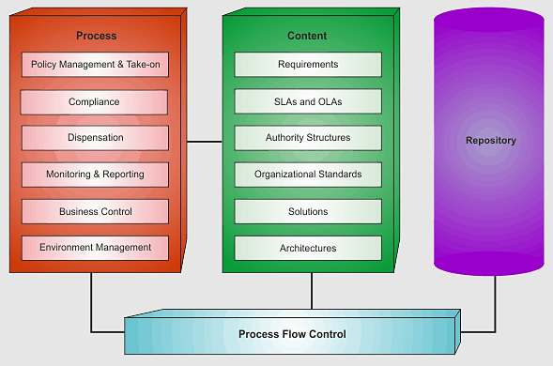
Architecture Governance Framework
“a conceptual and organizational framework for architecture governance.”
Conceptual Structure

Slide 62
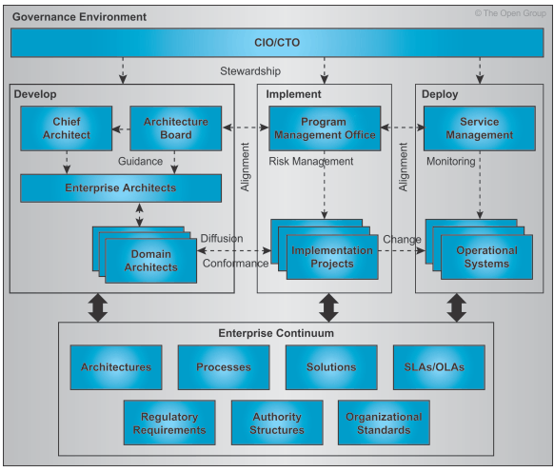
Architecture Governance Framework
Organizational Structure

Slide 63
Phase G Steps
The order of the steps should be adapted to the situation.
1. Confirm Scope and Priorities for Deployment with Development Management
2. Identify Deployment Resources and Skills
3. Guide Development of Solutions Deployment
4. Perform Enterprise Architecture Compliance Reviews
5. Implement Business and IT Operations
6. Perform Post-Implementation Review and Close the Implementation

Slide 64
Architecture Change Management
H
Establishes procedures for managing change to the new architecture.

Slide 65
Objective
Provide continual monitoring and a change management process to ensure that the architecture responds to the needs of the enterprise and maximizes the value of the architecture to the business.

Slide 66
The goal of an architecture change management process is to ensure that the architecture achieves its original target business value. This includes managing changes to the architecture in a cohesive and architected way.
This process will typically provide for the continual monitoring of such things as governance requests, new developments in technology, and changes in the business environment.
When changes are identified, change management will determine whether to formally initiate a new architecture evolution cycle.
In Phase H it is critical that the governance body establish criteria to judge whether a Change Request warrants just an architecture update or whether it warrants starting a new cycle of the Architecture Development Method (ADM). It is especially important to avoid "creeping elegance", and the governance body must continue to look for changes that relate directly to business value.

Slide 67
Drivers for Change
There are three ways to change the existing infrastructure that have to be integrated:
Strategic, top-down directed change to enhance or create new capability (capital)
Bottom-up changes to correct or enhance capability (operations and maintenance) for infrastructure under operations management
Experiences with the previously delivered project increments in the care of operations management, but still being delivered by ongoing projects

Slide 68
Enterprise Architecture Change Management Process
Architectural changes can be classified into one of three categories:
Simplification change: A simplification change can normally be handled via change management techniques.
Incremental change: An incremental change may be capable of being handled via change management techniques, or it may require partial re-architecting, depending on the nature of the change .
Re-architecting change: A re-architecting change requires putting the whole architecture through the architecture development cycle again.

Slide 69
A good rule-of-thumb is:
If the change impacts two stakeholders or more, then it is likely to require an architecture redesign and re-entry to the ADM.
If the change impacts only one stakeholder, then it is more likely to be a candidate for change management.
If the change can be allowed under a dispensation, then it is more likely to be a candidate for change management.

Slide 70
Phase H Steps
The order of the steps should be adapted to the situation.
1. Establish Value Realization Process
2. Deploy Monitoring Tools
3. Manage Risks
4. Provide Analysis for Architecture Change Management
5. Develop Change Requirements to Meet Performance Targets
6. Manage Governance Process
6. Activate the Process to Implement Change

Slide 71
Requirements Management
Examines the process of managing architecture requirements throughout the ADM.

Slide 72
Objective
Ensure that the architecture lifecycle is maintained.
Ensure that the Architecture Governance Framework is executed.
Ensure that the enterprise Architecture Capability meets current requirements.
Ensure that the Requirements Management process is sustained and operates for all relevant ADM phases

Slide 73
Architecture Content Framework
“provides a detailed model of architectural work products, including deliverables, artefacts within deliverables, and the Architecture Building Blocks (ABBs) that deliverables represent.”
It helps to improve the consistency of the TOGAF outputs by presenting outputs in a consistent and structured way, and also helps to reference and classify them.
It provides a comprehensive checklist of architecture outputs, it promotes better integration of work products, and provides a detailed open standard for how architectures should be described.
A structured store house for the products of the ADM cycle.

Slide 74
Content Framework
The Architecture Content Framework uses the following three categories to describe the type of architectural work product within the context of use:
A deliverable is a work product that is contractually specified and in turn formally reviewed, agreed, and signed off by the stakeholders.
Deliverables represent the output of projects and those deliverables that are in documentation form will typically be archived at completion of a project, or transitioned into an Architecture Repository as a reference model, standard, or snapshot of the Architecture Landscape at a point in time.
An artifact is a more granular architectural work product that describes an architecture from a specific viewpoint. Examples include a network diagram, a server specification, a use-case specification, a list of architectural requirements, and a business interaction matrix. Artifacts are generally classified as catalogs (lists of things), matrices (showing relationships between things), and diagrams (pictures of things). An architectural deliverable may contain many artifacts and artifacts will form the content of the Architecture Repository.
A building block represents a (potentially re-usable) component of business, IT, or architectural capability that can be combined with other building blocks to deliver architectures and solutions. Building blocks can be defined at various levels of detail and can relate to both architectures and solutions, with Architecture Building Blocks (ABBs)
typically describing the required capability in order to shape the Solution Building Blocks (SBBs) which would represent the components to be used to
implement the required capability.

Slide 75
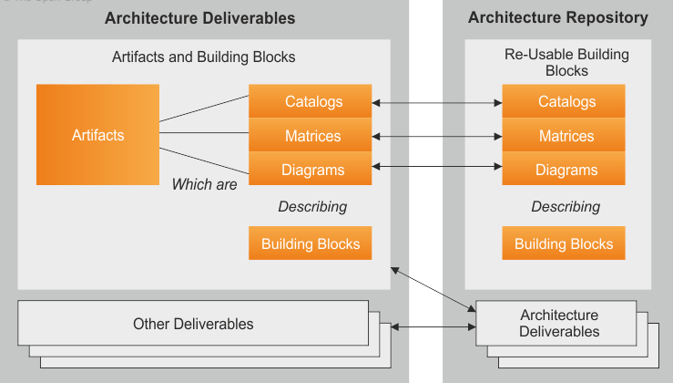
The relationships between deliverables, artefacts, and building blocks
Architecture Building Blocks (ABBs) typically describe required capability and shape the specification of Solution Building Blocks (SBBs). For example, a customer services capability may be required within an enterprise, supported by many SBBs, such as processes, data, and application software.
Solution Building Blocks (SBBs) represent components that will be used to implement the required capability. For example, a network is a building block that can be described through complementary artefact's and then put to use to realize solutions for the enterprise.

Slide 76
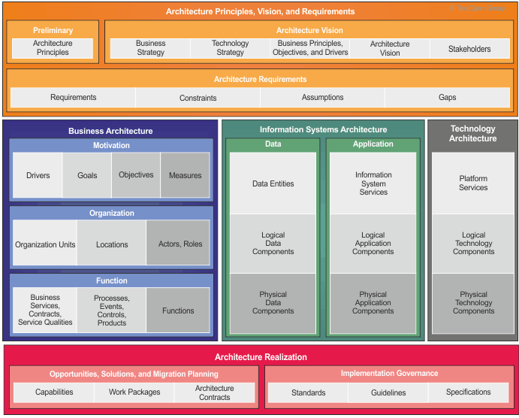
Content Metamodel
Provides a definition of all the types of building blocks that may exist within an architecture, showing how these building blocks can be described and related to one another.

Slide 77
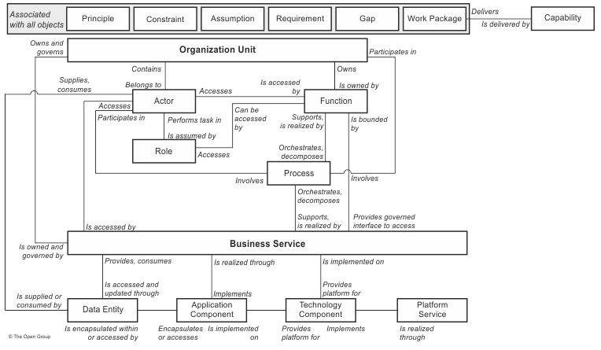
Metamodel entities and Their Relationships

Slide 78
Building Blocks
Building blocks have generic characteristics as follows:
A building block is a package of functionality defined to meet the business needs across an organization.
A building block has a type that corresponds to the TOGAF content metamodel (such as actor, business service, application, or data entity)
A building block has a defined boundary and is generally recognizable as "a thing" by domain experts.
A building block may interoperate with other, inter-dependent, building blocks.
A good building block has the following characteristics:
It considers implementation and usage, and evolves to exploit technology and standards.
It may be assembled from other building blocks.
It may be a subassembly of other building blocks.
Ideally a building block is re-usable and replaceable, and well specified.

Slide 79

The Enterprise Continuum
The Enterprise Continuum is a view of the Architecture Repository that provides methods for classifying architecture and solution artefacts as they evolve from generic Foundation Architectures to Organization-Specific Architectures.
The Enterprise Continuum comprises two complementary concepts:
Architecture Continuum- offers a consistent way to define and understand the generic rules, representations, and relationships in an architecture, including traceability and derivation relationships (e.g., to show that an Organization-Specific Architecture is based on an industry or generic standard). Represents a structuring of Architecture Building Blocks (ABBs)
Solutions Continuum -The Solutions Continuum provides a consistent way to describe and understand the implementation of the assets defined in the Architecture Continuum. The Solutions Continuum defines what is available in the organizational environment as re-usable Solution Building Blocks (SBBs).
The Enterprise Continuum provides a view of the Architecture Repository that shows the evolution of these related architectures from generic to specific, from abstract to concrete, and from logical to physical.
Consists of all the architecture assets; that is, models (eg. TRM), patterns, architecture descriptions, and other artifacts produced during application of the ADM.

Slide 80
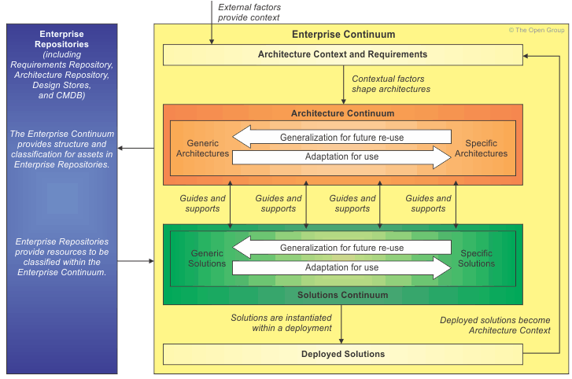
The Enterprise Continuum

Slide 81
The Architecture Continuum
A Foundation Architecture is an architecture of building blocks and corresponding standards that supports all the Common Systems Architectures and, therefore, the complete enterprise operating environment.Eg the Technical Reference Model(TRM)
Organization-Specific Architectures are the most relevant to the IT customer community, since they describe and guide the final deployment of user-written or third-party components that constitute effective solutions for particular enterprises.
Common Systems Architectures guide the selection and integration of specific services from the Foundation Architecture to create an architecture useful for building common solutions across a wide number of relevant domains. Eg Integrated Information Infrastructure Reference Model (III-RM)
Industry Architectures guide the integration of common systems components with industry-specific components, and guide the creation of industry solutions for specific customer problems within a particular industry.
Foundation Arch.
Common Systems Arch.
Industry Arch.
Organization Arch.

Slide 82
The Solutions Continuum
An Organization-Specific Solution is an implementation of the Organization- Specific Architecture that provides the required business functions.
They contain the highest amount of unique content in order to accommodate the varying
people and processes of specific organizations.
Common Systems Solutions represent collections of common requirements
and capabilities, rather than those specific to a particular customer or industry. Common Systems Solutions provide organizations with operating environments specific to operational and informational needs, such as high
availability transaction processing and scalable data warehousing systems. Examples of Common Systems Solutions include: an enterprise management system product and a security system product.
Foundation Solutions are highly generic concepts, tools, products, services, and solution components that are the fundamental providers of capabilities. Eg programming languages, operating systems, foundational structures for
organizing IT operations (such as ITIL)
An Industry Solution is an implementation of an Industry Architecture, which provides re-usable packages of common components and services specific to an industry. Fundamental components are provided by Common Systems Solutions and/or Foundation Solutions, and are augmented with industry-specific components.
Foundation Arch.
Common Systems Arch.
Industry Arch.
Organization Arch.

Slide 83
Architecture Capability Framework
Architecture Capability Framework Contents:
Chapter | Description
Establishing an Architecture Capability | Guidelines for establishing an Architecture Capability within an organization.
Architecture Board | Guidelines for establishing and operating an enterprise Architecture Board.
Architecture Compliance | Guidelines for ensuring project compliance to architecture.
Architecture Contracts | Guidelines for defining and using Architecture Contracts.
Architecture Governance | Framework and guidelines for Architecture Governance.
Architecture Maturity Models | Techniques for evaluating and quantifying an organization’s maturity in enterprise architecture.
Architecture Skills Framework | A set of role, skill, and experience norms for staff undertaking enterprise architecture work.

Slide 84
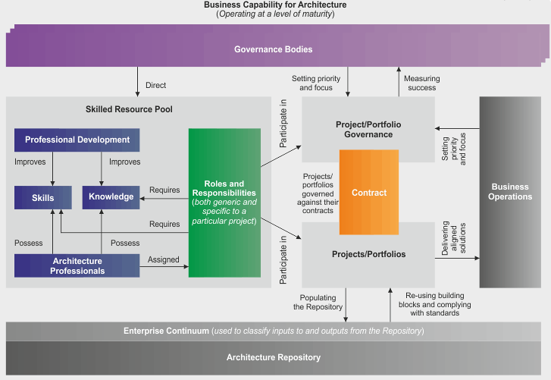
Architecture Capability Framework

Slide 85
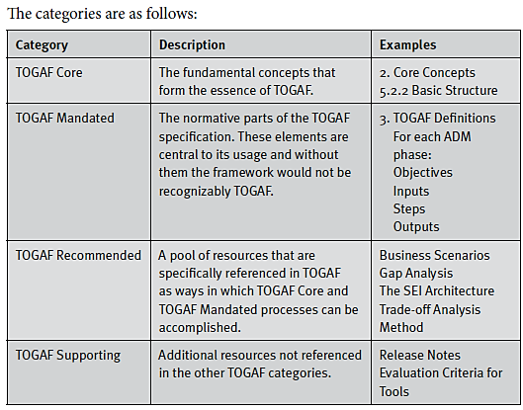
TOGAF Document Categorization Model

Slide 86
Version Management
Phase | Deliverable | Content | Version | Description
A: Architecture Vision | Architecture Vision | Business Architecture | 0.1 | Version 0.1 indicates that a high-level outline of the architecture is in place.
 |  | Data Architecture | 0.1
 |  | Application Architecture | 0.1
 |  | Technology Architecture | 0.1
B: Business Architecture | Architecture Definition Document | Business Architecture | 1.0 | Version 1.0 indicates a formally reviewed, detailed architecture.
C: Information Systems Architecture | Architecture Definition Document | Data Architecture | 1.0
 |  | Application Architecture | 1.0
D: Technology Architecture | Architecture Definition Document | Technology Architecture | 1.0

Slide 87
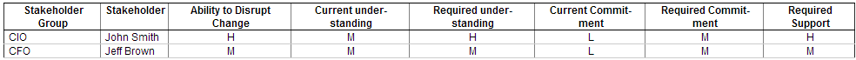
Stakeholder Management
“helps them ensure that their projects succeed where others fail by managing Stakeholders.”
Classify Stakeholder Positions
Determine Stakeholder Management Approach
C
Keep Satisfied
D
Key Players
High
Power
A
Minimal Effort
B
Keep Informed
Low
Low
High
Level Of Interest

Slide 88
Gap Analysis
“It is used to validate an architecture that is being developed.”
Draw up a matrix with all the Architecture Building Blocks (ABBs) of the Baseline Architecture on the vertical axis, and all the ABBs of the Target Architecture on the horizontal axis.
Add to the Baseline Architecture axis a final row labeled "New", and to the Target Architecture axis a final column labeled "Eliminated".
Where an ABB is available in both the Baseline and Target Architectures, record this with "Included" at the intersecting cell.
Where an ABB from the Baseline Architecture is missing in the Target Architecture, each must be reviewed. If it was correctly eliminated, mark it as such in the appropriate "Eliminated" cell. If it was not, an accidental omission in the Target Architecture has been uncovered that must be addressed by reinstating the ABB in the next iteration of the architecture design - mark it as such in the appropriate "Eliminated" cell.
Where an ABB from the Target Architecture cannot be found in the Baseline Architecture, mark it at the intersection with the "New" row as a gap that needs to filled, either by developing or procuring the building block.

Slide 89
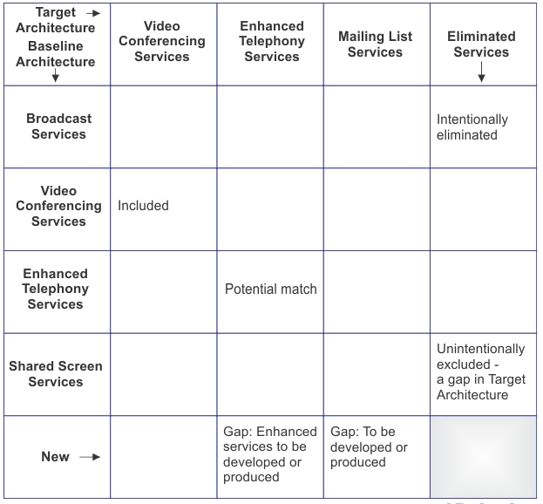
Gap Analysis Example :

Slide 90
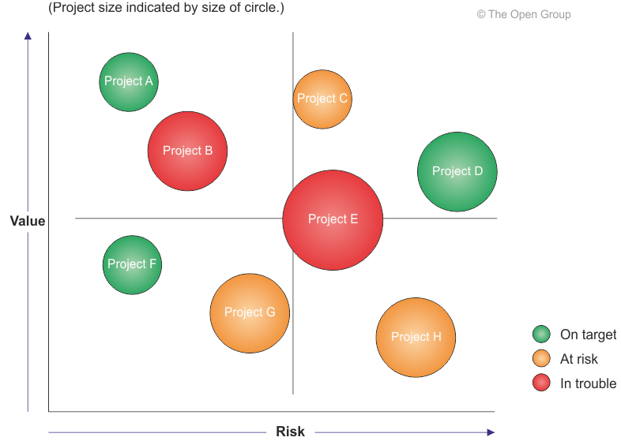
Migration Planning Technique
Business Value Assessment Technique

Slide 91
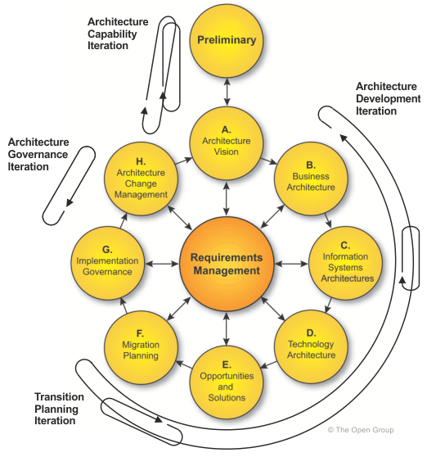
Iteration Cycles

Slide 92
Views & View Points
Views
View Points
Key:
Data
(What)
Function
(How)
Network
(Where)
People
(Who)
Time
(When)
Motivation
(Why)
Business Architecture
Architecture View : A view is a representation of a system from the perspective of a related set of concerns. A view is what you see (or what a stakeholder sees). Views are specific.
Architecture Viewpoint: where you are looking from; the vantage point or perspective. Viewpoints are generic. A model (or description) of the information contained in a view.
Planer View
List of important things to enterprise
List of processes
the enterprise performed
List of locations where the enterprise operates
List of organization units
Lit of business events/cycles
List of business objectives
Owner’s View
Entity Relationship diagram
Business Process Model
Logistics Network
Organizational Chart
Business Master Schedule
Business Rules
Information Architecture
Designer’s View
Data model
Essential data flow, application architecture
Distributed system architecture
Human interface architecture
Dependency diagram, entity life history
Business Rule model
Information & comm. Technology Architecture
Builder’s View
Data Architecture
System design: structure chart, pseudo code
Systems Architecture
User interface design
Control flow diagram
Business Rule design
Detailed View
Data design, physical storage
Detailed program design
Network Architecture
Screens
Timing of definitions
Rule specification in program logic
Operational View
Converted Data
Executable programs
Communications facilities
Trained people
Business events
Enforced rule
Zachman Framework

Slide 93
Capability-Based Planning
“focuses on the planning, engineering, and delivery of strategic business capabilities to the enterprise.”
It is business-driven and business-led and combines the requisite efforts of all lines of business to achieve the desired capability.
Capability-based planning accommodates most, if not all, of the corporate business models.
Many capabilities are "horizontal" and go against the grain of normal vertical corporate governance.
Three Capability Dimensions:
People: Training
Process: Business Processes/Information Management
Material: Infrastructure/Technology/Equipment

Slide 94
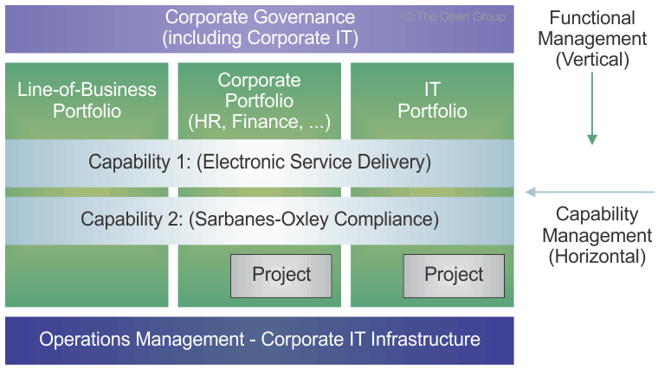
Capability-Based Planning
Many capabilities are "horizontal" and go against the grain of normal vertical corporate governance.

Slide 95

Architecture Landscape
Shows how the AM (Architectural Model) has changed over time.
Strategic Architecture provides an organizing framework for operational and change activity and allows for direction setting at an executive level.
Segment Architecture provides an organizing framework for operational and change activity and allows for direction setting and the development of effective architecture roadmaps at a program or portfolio level.
Capability Architecture provides an organizing framework for change activity and the development of effective architecture roadmaps realizing capability increments.
2000
2005
2010
2015
Strategic Architecture
AM 1
AM2
AM3
AM4
Segment Architecture
Capability Architecture
Architecture Landscape

Slide 96
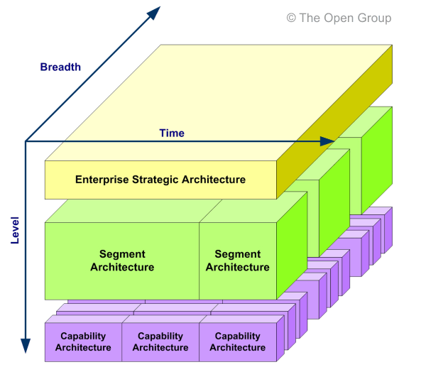
Architecture Landscape
Levels provide a framework for dividing the Architecture Landscape into three levels of granularity:

Slide 97
Foundation Architecture: Technical Reference Model (TRM)
The Foundation Architecture is embodied within the Technical Reference Model (TRM), which provides a model and taxonomy of generic platform services.
The TRM is universally applicable and, therefore, can be used to build any system architecture.
Any TRM has two main components: (same as III-RM)
A taxonomy, which defines terminology, and provides a coherent description of the components and conceptual structure of an information system.
An associated TRM graphic, which provides a visual representation of the taxonomy, as an aid to understanding.

Slide 98
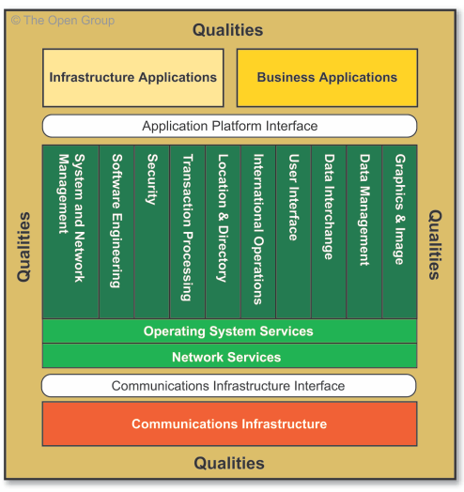
Foundation Architecture: Technical Reference Model (TRM)
TRM graphic

Slide 99
Integrated Information Infrastructure Reference Model (III-RM)
“The ability of information to permeate boundaries such as departments and organisations.”
The III-RM is a subset of the TOGAF TRM in terms of its overall scope, but it also expands certain parts of the TRM - in particular, the business applications and infrastructure applications parts - in order to provide help in addressing one of the key challenges facing the enterprise architect today: the need to design an integrated information infrastructure to enable Boundaryless Information Flow.
The model assumes the underlying existence of a computing and network platform, as described in the TRM.
This is a Common Systems Architecture.

Slide 100
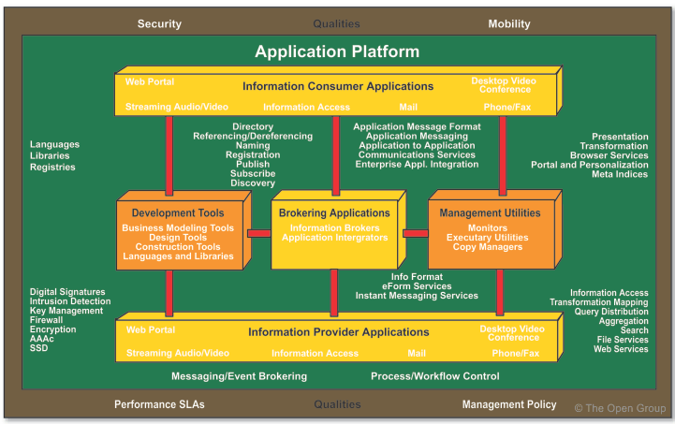
Integrated Information Infrastructure Reference Model (III-RM)
Detailed III-RM Graphic

Slide 101

The End
Contact: Samuel Mandebvu
+27 72 924 4238
sam@zimeletechnologies.com

